Slide 1
Evaluating Educational Technology Initiatives: How Do You Know It’s Working?

Slide 2
Introduction
Learn about – and get the tools for –conducting a successful evaluation
Set appropriate expectations for instructional technology evaluation
Reflect on the value that such a process can bring to your district’s efforts.

Slide 3
Sun Associates
www.sun-associates.com
Who we are
What we do
What’s on your USB drive
www.sun-associates.com/saevalws
You?

Slide 4
Framing the task for Program Evaluation
Deconstructing “Working”
Defined by the goals of your project
Defined by intent
Evaluation = A structured process for examining the relationship between intent/actions and outcomes

Slide 5
Very focused projects
Whole district technology plans
The basic process is the same
Today, we’re focusing on a whole district technology plan – aka, technology audit.

Slide 6
The Sun Associates Process
An “open-source” approach to technology program evaluation
You can modify components of the process as necessary/if desired
A process for examining outcomes as measured by intent
The process allows you to reflect on your intent and the anticipated outcomes related to that intent

Slide 7
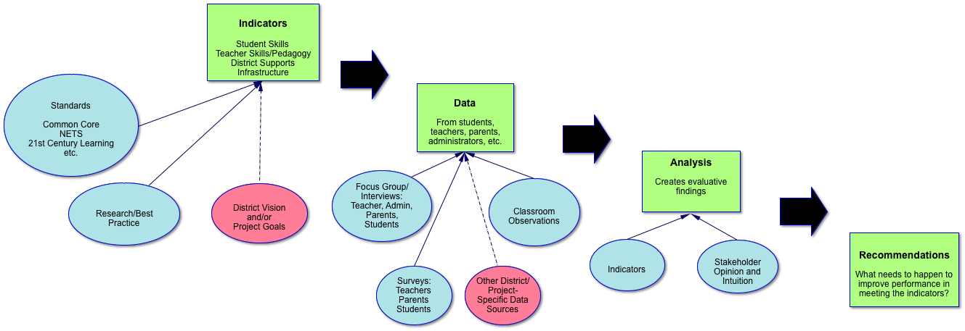
Sun Associates’ Process

Slide 8
Mixed Methods
Qualitative and quantitative
Stakeholder-based
Focused on unique needs/situations
Open Source
Allows for incorporation of existing measures/metrics
Generative of reflection
Excellent for both on-going-improvement, formative work, and planning work.
Produces “answers” for those who need those

Slide 9
Sun Associates’ Process

Slide 10
Questions?

Slide 11
Working an Example Together
Take a look at the tools…
Indicator/question matrix
Universe of data
Finding references in the data
Quantitative and Qualitative
What do we think the data says?
That’s a finding!

Slide 12
Now You Do It
4 teams
Teams will model the data review and analysis process for a single indicator
Today, 2 teams per indicator
In “real life” your committee would need to do this for all FOUR indicators
Review your team’s indicator, questions, and data
Develop basic findings
40 minutes!

Slide 13
Pair-Share
Find the other team that worked on your indicator
15 minutes to pair-share what you found
What are the findings you developed for your indicator?

Slide 14
Questions?

Slide 15
Expanding the Process
Modifying the Indicators
Connecting the indicators to your specific project outcomes
Using different/additional questions
Sun Associates’ Question Bank
Weaving-in existing tools and data

Slide 16
Wrap-up
For additional assistance…
Sun Associates’ evaluation support website
What’s coming there next
Jeff Sun – jsun@sun-associates.com
978-251-1600 ext. 204

